Slide 1

The Best Run SAP Hackathon Polytechnics University Bucharest 27-28 October 2018

Slide 2

Agenda
Saturday | 27.10.2018
19:00 | Check in
20.00 | Presentations SAP + Best | Gheorghe Olteanu Bogdan Cioc
20.30 | The contest | Radu Purdel
 | Hackathon – jury, mentors, awards | Ruxandra Custura
21.00 | Start Hackathon 12 h
23.00 | Midnight Snack
Sunday | 28.10.2018
04.00 | Dawn Snack
08.00 | Stop Hackathon
08.15 | Team presentations (6 min / team)
10.15 | Jury debate + preparation of diplomas | Jury + BEST
10.30 | Awards ceremony

Slide 3




SAP - from the Digital Era to the Intelligence Era
ENABLING TECHNOLOGIES
Mainframe & PCs
1960s – 1980s
Client Server & Internet
1990s - 2000s
Cloud, Mobile & Big Data
2000s - 2010s
Intelligent Technologies
2010s - 2020s
Transistors & silicon revolution
Large scale Mainframe Computing adoption
Emergence of PC’s
Plant floor automation
Widespread PC adoption
Broadband Internet
ERP and business process technologies
Mobile & Smartphone ubiquity
Cloud Computing
Social Networks
Big Data
Machine learning (ML) and artificial intelligence (AI)
Internet of things (IoT) and distributed computing
Blockchain
CUSTOMER VALUE CREATION
Industrial Automation
Business Process Automation
Digital Transformation
Intelligent Enterprise

Slide 4
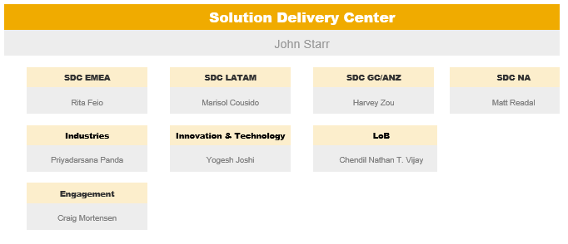
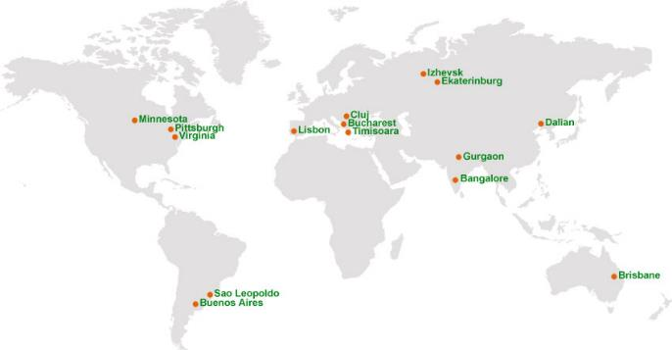
Solution Delivery Center (SDC)
We Are…
Integrated consulting delivery arm of GCD with Near and Offshore centers providing global coverage, strength of 2000+
Global talent pool of consultants driven to deliver outcomes for our customers through both Factory and Traditional people based services.
Focused on continuous improvement to increase Customer Satisfaction while lowering Costs and accelerating TIme-to-Value.
Solution
Delivery
Center
(SDC)
Process Improve-ment
Cycle Time Reduction
Lower FLCR
Early Talent
Standard Processes
Standard Offerings

Slide 5
EMEA Solution Delivery Center Facts
Center | Romania | Portugal | CIS
LOCATIONS | Bucharest, Timisoara, Cluj | Lisbon | Ekaterinburg
START IN | July, 2011 (transferred from Global Delivery) | April, 2012 (build up new) | July, 2015 (build up new)
HC DEVELOPMENT
LANGUAGES | Romanian, English, German, Italian, French, Russian, Hungarian | Portuguese, English, Spanish, Italian, French, German | Russian, English, German, French
+ 660 consultants delivering Innovation Services by end of 2017

Slide 6
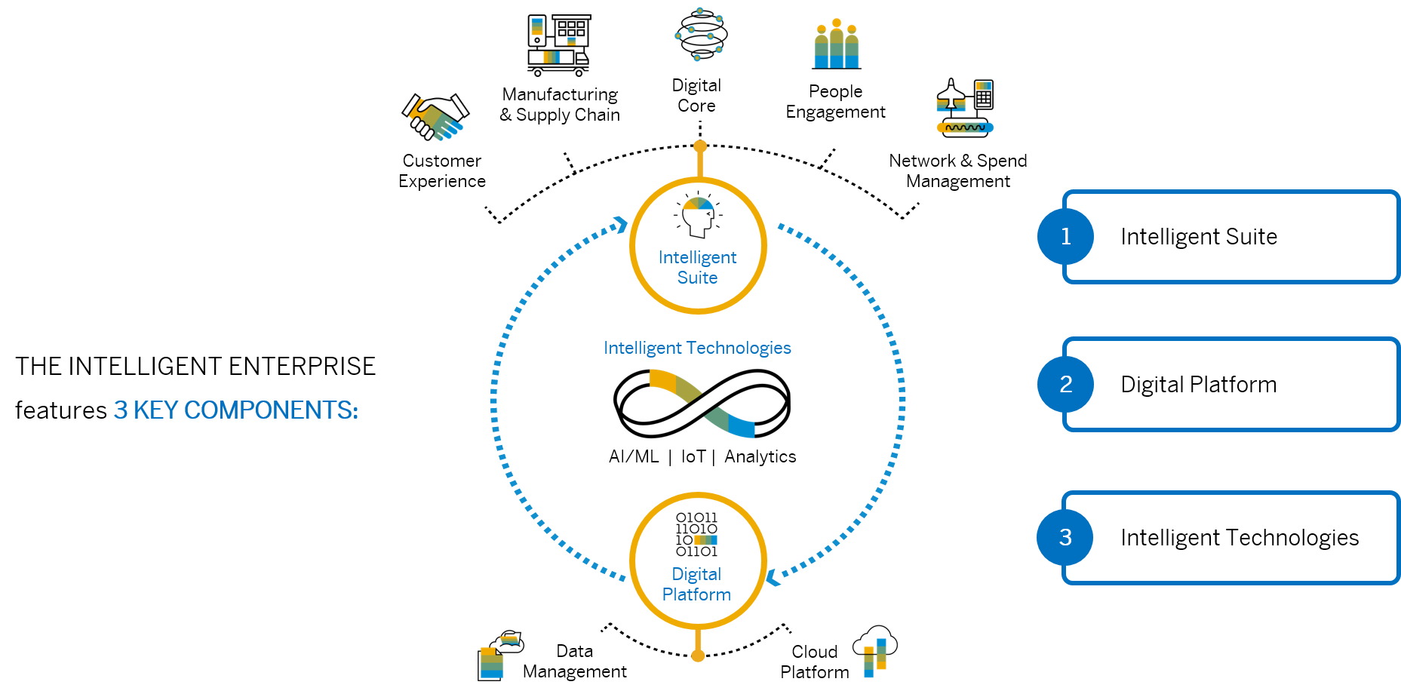
Software Development @ SAP
Learn more about the Intelligent Enterprise at
sap.com/intelligententerprise

Slide 7
The Best Run SAP Hackathon Jury, Mentors, Awards
Awards
10 internships at SAP
1 visit at the SAP Innovation Center Potsdam, Germany
12 hours of work
12 teams x 3 hackers
15 mentors
Bogdan Cioc
Consulting Manager Development Services
Traian Ionescu
Consulting Manager Analytics Services
Bogdan Neagoie
Development Architect
(representing Andrei Tufis, Development Manager SAP Product Lifecycle Costing)
Radu Purdel
Senior Data Scientist
(representing Viorel Marcu, Head of Data Science Romania)
Diana Chirilă
SAP Cloud Platform Presales Specialist
Jury

Slide 8
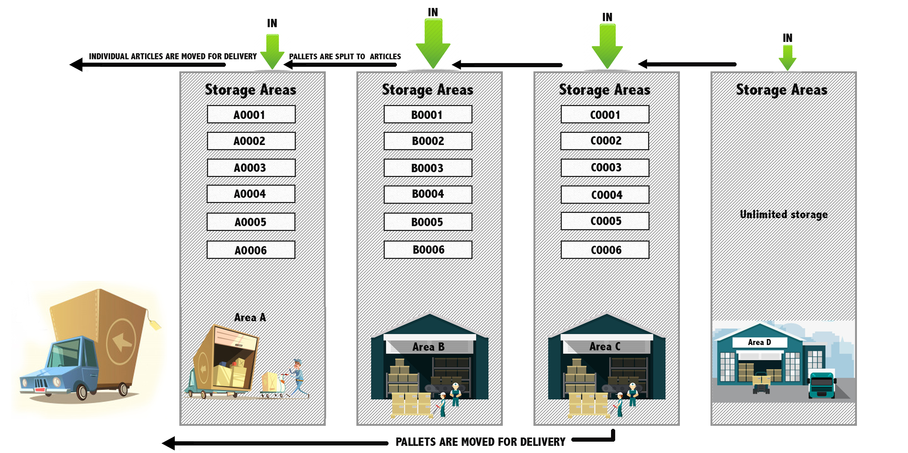
Contest and scorecard
Scoring
Interface with data API | 10 points
Visualization of warehouse content | 20 points + 10 bonus points
Simulation of warehouse operations | 30 points
Calculate required KPIs | 30 points
Analytics and visualization | 40 points + 35 bonus points
Forecast of deliveries | 30 bonus points
Labelling | 20 points
Product availability optimization | 40 points
Deploy on SAP Cloud Platform | 20 points
Log performed action to remote API | 10 points
Overall Architecture | Bonus points
Presentation | Bonus points
Team synergy | Bonus points
Fun! | Bonus points
Documentation in
this Github repository

Slide 9

GO CODE!

Slide 10

Thank you.
ruxandra.custura@sap.com

